Slide 1
Radix Sort and Counting Sort
Dr. Jagadeesh Kakarla
Assistant Professor

Slide 2
void quickSort(int arr[], int low, int high)
{
if (low < high)
{
int pivotIndex = partition(arr, low, high);
quickSort(arr, low, pivotIndex - 1);
quickSort(arr, pivotIndex + 1, high);
}
}

Slide 3
int partition(int arr[], int low, int high) {
int pivot = arr[low];
int i = low + 1;
int j = high;
while (1) {
while (i <= j && arr[i] <= pivot) i++;
while (j >= i && arr[j] > pivot) j--;
if (i <= j) { int temp = arr[i]; arr[i] = arr[j]; arr[j] = temp; }
else { int temp = arr[low]; arr[low] = arr[j]; arr[j] = temp; return j; }
} }

Slide 4
void printArray(int arr[], int size) {
int i;
for (i = 0; i < size; i++)
printf("%d ", arr[i]);
}
int main() {
int arr[] = {12, 7, 11, 5, 6};
int size = sizeof(arr) / sizeof(arr[0]);
printf("Original array: ");
printArray(arr, size);
quickSort(arr, 0, size - 1);
printf("Sorted array: ");
printArray(arr, size);
return 0;
}

Slide 5
Radix Sort
Radix sort is a non-comparative sorting algorithm that works by distributing elements into buckets based on their individual digits or radix.
It processes the digits from the least significant digit (LSD) to the most significant digit (MSD) or vice versa.

Slide 6
Working process
Identify the maximum number of digits in the given set of numbers. This will determine the number of passes the algorithm needs to make.
For each pass, use a stable sorting algorithm to distribute the elements into buckets based on the value of the current digit.
After each pass, gather the elements from all the buckets in the order they were placed.
Repeat the process for each digit, moving towards the other end of the numbers.
After processing all the digits, the numbers are sorted.

Slide 7
170, 45, 75, 90, 802, 24, 2, 66

Slide 8
Counting sort
Counting Sort is a non-comparative sorting algorithm that operates by counting the number of occurrences of each element in the input.
It works well when the range of input values (the difference between the maximum and minimum values) is not significantly greater than the number of elements in the input array.

Slide 9
Identify the range of input values, i.e., the minimum and maximum values in the array.
Create an auxiliary array, often called the counting array, to store the count of occurrences of each distinct element in the input array.
Traverse the input array and, for each element, increment the corresponding index in the counting array.
Modify the counting array so that each element at an index i contains the sum of the counts of elements less than or equal to i.
The above step helps determine the final position of each element in the sorted array.
Create the output array by placing elements in their sorted order based on the counting array.
For each element arr[i] in the input array, find its count in the counting array, decrement the count, and place arr[i] at the determined position in the output array.

Slide 10
2 9 7 4 1 8 4

Slide 11
Inplace sorting algorithm:
An in-place sorting algorithm is a sorting algorithm that doesn't require extra memory space proportional to the input size; it sorts the data structure within its own memory.
Bubble sort
Insertion sort
Selection sort
Heap sort
Quick sort

Slide 12
Stable algorithm: A stable sorting algorithm maintains the relative order of equal elements in the sorted output as they were in the input.
Merge sort
Insertion sort
Bubble sort
Selection sort
Counting sort
Radix sort

Slide 13
Bubble Sort and Insertion sort
Average Time Complexity: O(n^2)
Worst Time Complexity: O(n^2)
Best Time Complexity: O(n) - when the list is already sorted
Selection Sort:
Average, Best, Worst Time Complexity: O(n^2)
Merge Sort and Heap sort:
Average, Best, Worst Time Complexity: O(n log n)
Quick Sort:
Average Time Complexity: O(n log n)
Worst Time Complexity: O(n^2)
Best Time Complexity: O(n log n)
Counting Sort:
Average, Best, Worst Time Complexity: O(n + k), where k is the range of the non-negative key values
Radix Sort:
Average, Best, Worst Time Complexity : O((n* d), where d is the number of digits in the maximum number

Slide 14

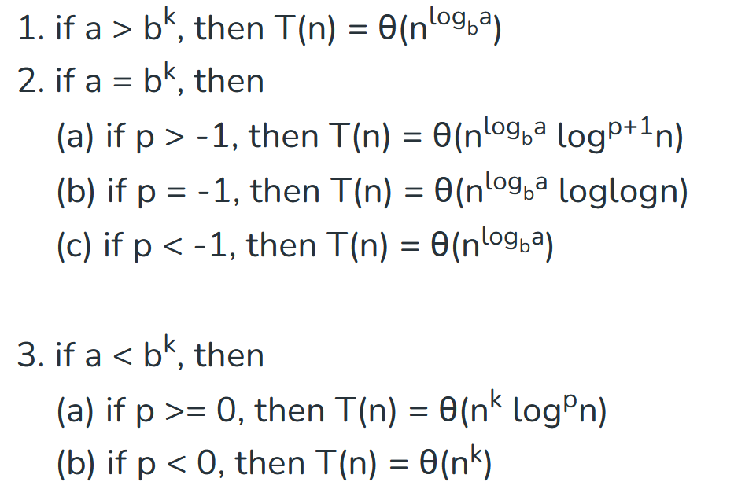
a>=1 , b> 1, k>=0, p is real number

Slide 15
T(n) = T(n/2) + 1

Slide 16
T(n) = 2T(n/2) + n

Slide 17
T(n) = 3T(n/2) + n²

Slide 18
T(n) = 3T(n/2) + log²n

Slide 19
T(n) = 2T(n/2) + nlog²n

Slide 20
T(n) = 2^{n}T(n/2) + n^{n}

